Slide 1

Physics-based
Character Movement
For dummies
Guilherme Gama

Slide 2

Player Movement

Slide 3

Player Movement
Necessary Inredients

Slide 4
Necessary Ingredients
Direct response to input
Simple navigation
Feedback, feeedback!

Slide 5
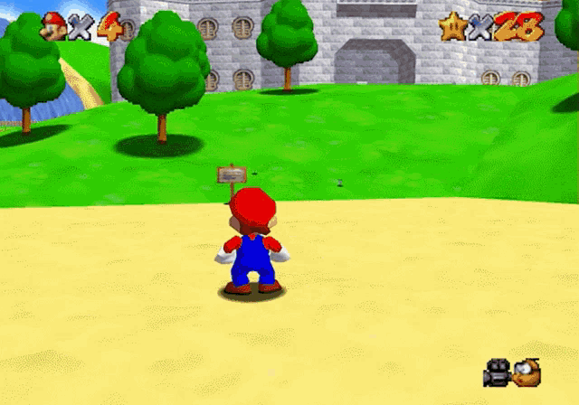

Slide 6

Necessary Ingredients
Direct response to input
Simple navigation
Feedback, feeedback!

Slide 7
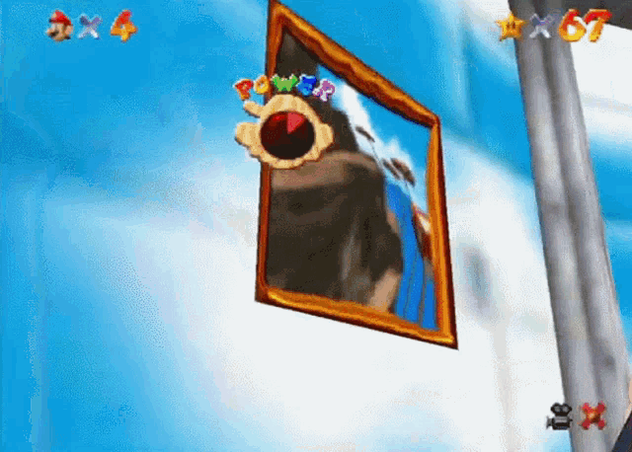

Slide 8
Necessary Ingredients
Direct response to input
Simple navigation
Feedback, feeedback!

Slide 9
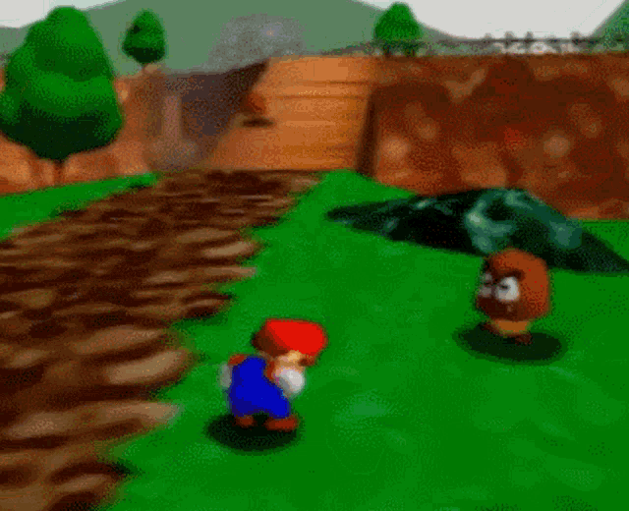

Slide 10
Necessary Ingredients
Direct response to input
Simple navigation
Feedback, feeedback!

Slide 11

Player Movement
Different ways

Slide 12

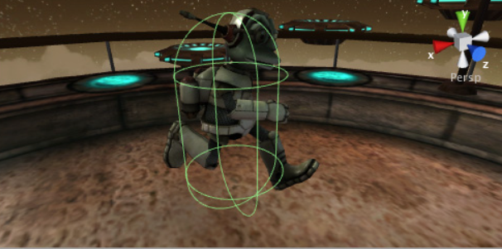
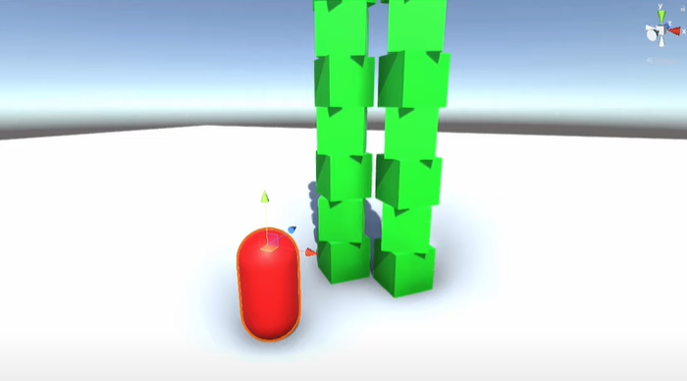
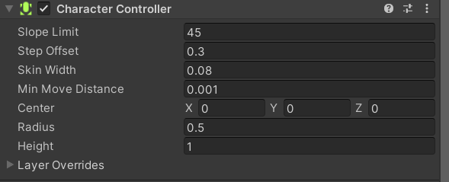
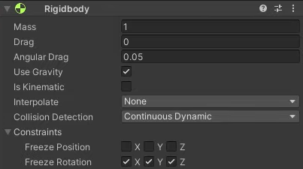

Built-in
Approach
Standard Capsule Approach
????
Approach

Slide 13

Player Movement
The major Obstacles

Slide 14
The major Obstacles
Besides actually having time to code the whole game
Friction
Ground checking
Slopes
Height differences

Slide 15


No Friction

Slide 16
With Friction

Slide 17
Starts Input
Stops Input
For Friction Approach
For Both Approaches
V = 0
V != 0
Fi
Ff
Ff
v

Slide 18
Ultra responsive Input

Slide 19
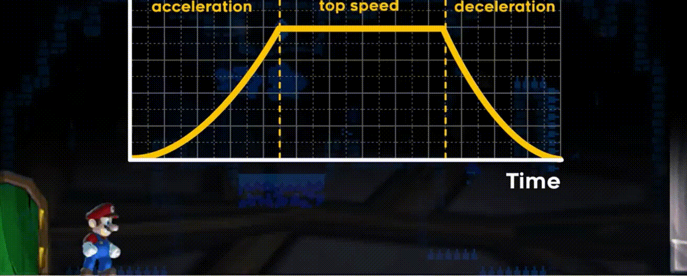
Source: Game Maker Toolkit - Youtube

Slide 20
The major Obstacles
Besides actually having time to code the whole game
Friction
Ground checking
Slopes
Height differences

Slide 22
Character is not on Ground
H > 0
So Ignore Input
h

Slide 24
The major Obstacles
Besides actually having time to code the whole game
Friction
Ground checking
Slopes
Height differences

Slide 25
Straight Plane

Slide 26
Inclined Plane

Slide 27
Inclined Plane

Slide 28
Inclined Plane
c = A Constant Value
c
n = Ground Normal
F = Final Force
n
F

Slide 29
Inclined Plane

Slide 30
Inclined Plane

Slide 32
c
Fi
n

Slide 33
C=000.1
Xv + c
Fi
v
Fii
n

Slide 35
v
Fi
Fii
n

Slide 38
The major Obstacles
Besides actually having time to code the whole game
Friction
Ground checking
Slopes
Height differences

Slide 40
Xv + c
n
F
v

Slide 42
The major Obstacles
Besides actually having time to code the whole game
Friction
Ground checking
Slopes
Height differences
??

Slide 43
Player Movement
Solution?

Slide 44

Floating Character Approach

Slide 45
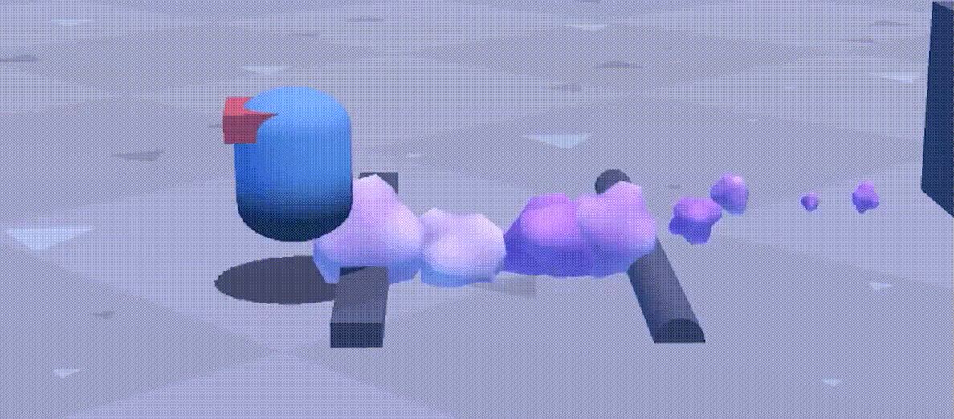
Source: Toyful Games- Youtube

Slide 46
Continue to part2

